Slide 1
Static member data, const and classes

Slide 2
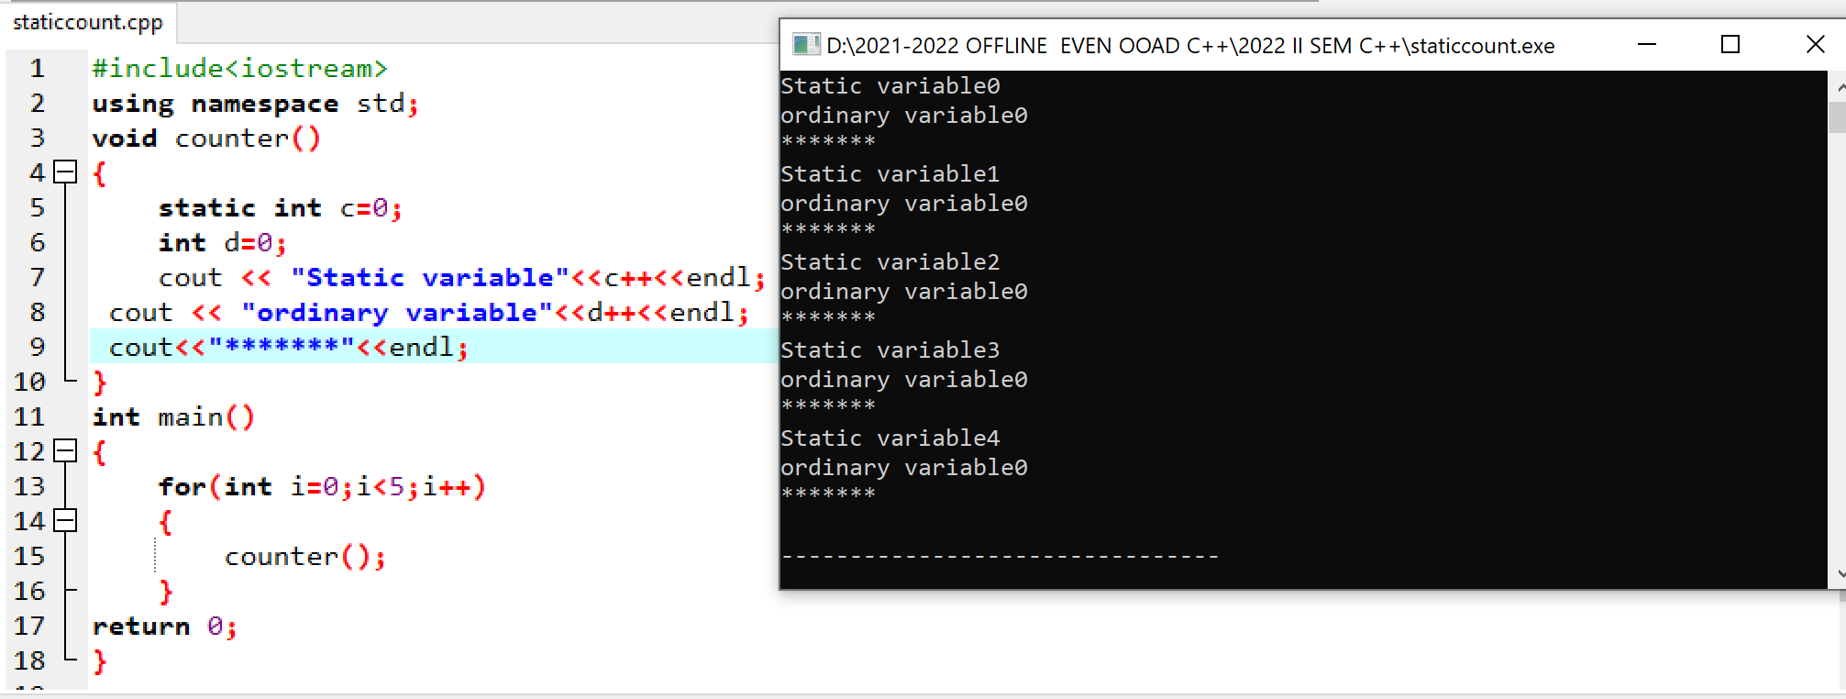

Slide 3
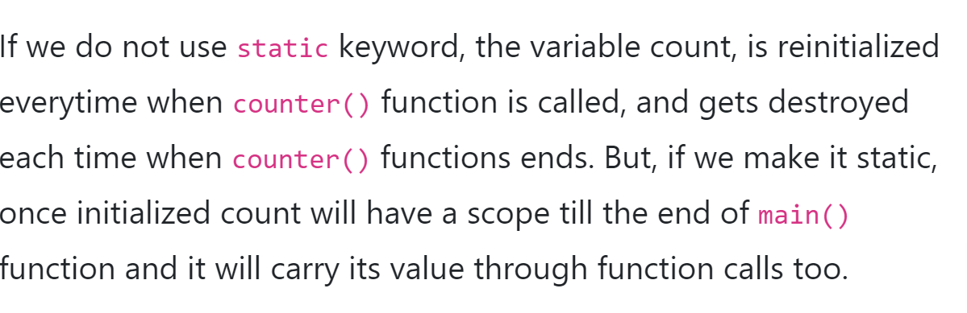

Slide 4
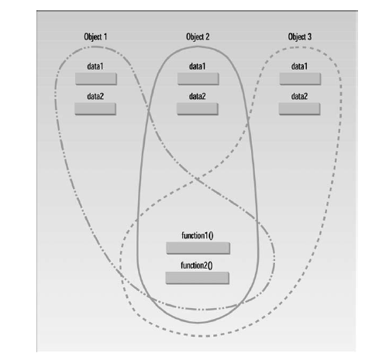
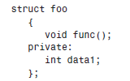
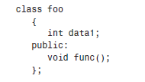
Structures and Classes
Classes, Objects, and Memory
use structures in almost exactly the same way that you use classes.
formal difference:
In a class the members are private by default, while in a structure they are public by default.

Slide 5
Static Class Data
If a data item in a class is declared as static, only one such item is created for the entire class
A static data item is useful when all objects of the same class must share a common item of information.
It is visible only within the class, but its lifetime is the entire program.
It continues to exist even if there are no objects of the class
class member data is used to share information among the objects of a class.

Slide 6
Separate Declaration and Definition
The variable’s declaration appears in the class definition, but the variable is actually defined outside the class, in much the same way as a global variable.
#include <iostream>
using namespace std;
class A {
static int Count;//declaration
public:
A() {
Count++;
}
void putdata() {
cout<<Count<<"\n";
}
};
int A::Count = 0;//definition
int main(void) {
A s1,s2,s3;
s1.putdata();
s2.putdata();
s3.putdata();
return 0;
}
3
3
3
--------------------------------
Process exited after 1.094 seconds with return value 0
Press any key to continue . . .

Slide 7
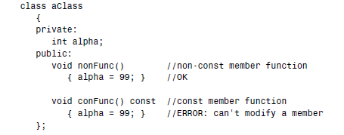
const and Classes
uses of const:
on member functions
on member function arguments,
on objects.
const Member Functions
A const member function guarantees that it will never modify any of its class’s member data
A function is made into a constant function by placing the keyword const after the declarator
but before the function body.
If there is a separate function declaration, const must be used in both declaration and definition

Slide 8
const Member Function Arguments
#include <iostream>
using namespace std;
class Demo
{
private:
int a;
public:
void set(int x)
{
a = x;
}
void sum(const Demo ob1, const Demo ob2)
{ a = ob1.a + ob2.a;
}
void print()
{cout<<"Value of A : "<<a<<endl;
}
};
int main()
{
Demo d1;
Demo d2;
Demo d3;
d1.set(10);
d2.set(20);
d3.sum(d1,d2);
d1.print();
d2.print();
d3.print();
return 0;
}

Slide 9

compiler will flag as an error any attempt to modify any member data of its argument
#include <iostream>
using namespace std;
class Demo
{
private:
int a;
public:
void set(int x)
{
a = x;
}
void sum(const Demo ob1, const Demo ob2)
{ a = ob1.a++ + ob2.a;
}
void print()
{cout<<"Value of A : "<<a<<endl;
}
};
int main()
{
Demo d1;
Demo d2;
Demo d3;
d1.set(10);
d2.set(20);
d3.sum(d1,d2);
d1.print();
d2.print();
d3.print();
return 0;
}

Slide 10
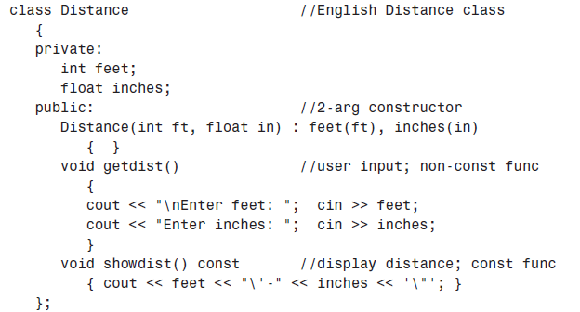
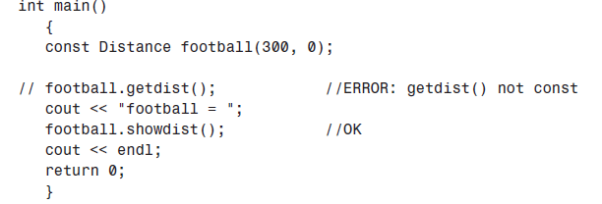
const Objects
When an object is declared as const, you can’t modify it.
It follows that you can use only const member functions with it, because they’re the only ones that guarantee not to modify it.
Whenever an object is declared as const, it needs to be initialized at the time of declaration. However, the object initialization while declaring is possible only with the help of constructors.

Slide 11
Create a class called time that has separate int member data for hours, minutes, and
seconds. One constructor should initialize this data to 0, and another should initialize it
to fixed values. Another member function should display it, in 11:59:59 format. The final member function should add two objects of type time passed as arguments.
A main() program should create two initialized time objects (should they be const?) and
one that isn’t initialized. Then it should add the two initialized values together, leaving the result in the third time variable. Finally it should display the value of this third variable. Make appropriate member functions const.

Slide 12
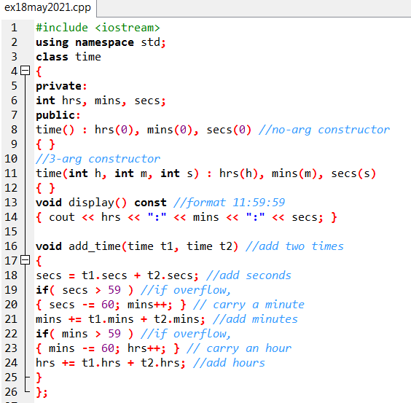

Slide 13
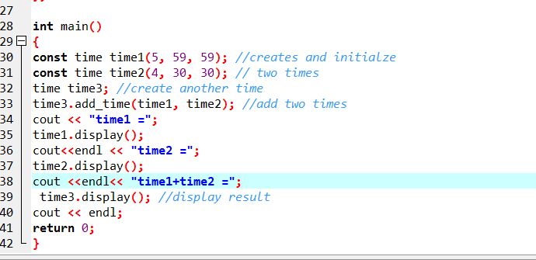

Slide 14
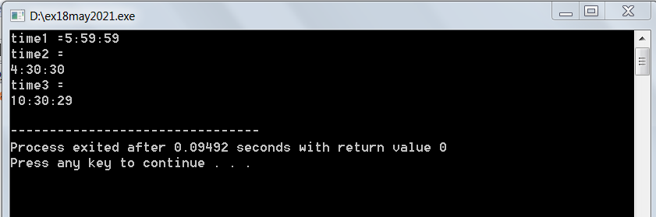

Slide 15
Imagine a tollbooth at a bridge. Cars passing by the booth are expected to pay a 50 cent toll. Mostly they do, but sometimes a car goes by without paying. The tollbooth keeps track of the number of cars that have gone by, and of the total amount of money collected.
Model this tollbooth with a class called tollBooth. The two data items are a type unsigned int to hold the total number of cars, and a type double to hold the total amount of money collected. A constructor initializes both of these to 0. A member function called payingCar() increments the car total and adds 0.50 to the cash total. Another function, called nopayCar(), increments the car total but adds nothing to the cash total. Finally, a member function called display() displays the two totals. Make appropriate member functions const. Include a program to test this class. This program should allow the user to push one key to count a paying car, and another to count a nonpaying car. Pushing the Esc key should cause the program to print out the total cars and total cash and then exit.
Include a program to test this class. This program should allow the user to push one key to count a paying car, and another to count a nonpaying car. Pushing the Esc key should cause the program to print out the total cars and total cash and then exit

